Slide 1
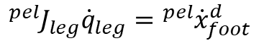
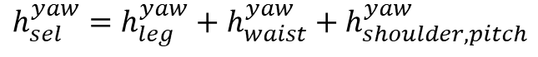
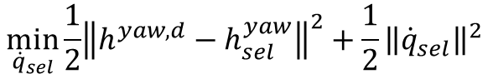
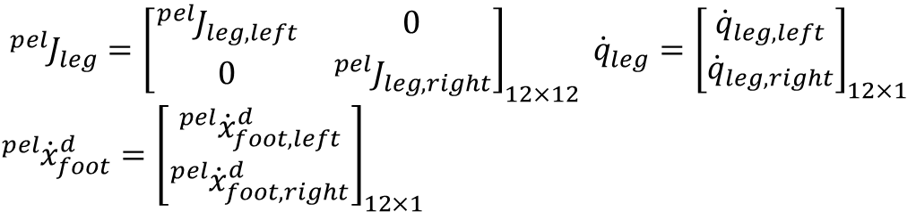
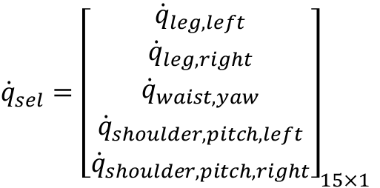
Centroidal dynamics
In this homework, the upper body joint motion is created to make the yaw momentum to zero.
Objective function
$$\min_{{\dot{q}}_{sel}}\frac{1}{2}{{\left\|h^{yaw,d}−h_{sel}^{yaw}\right\|}^{2}+\frac{1}{2}{\left\|{\dot{q}}_{sel}\right\|}^{2}}$$
→ Minimize the yaw momentum & ${\dot{q}}_{sel}$regulization
s.t.
$${}_{ }^{pel}{J_{leg}}{\dot{q}}_{leg}={}_{ }^{pel}{{\dot{x}}_{foot}^{d}}$$
The solution of the leg joint that satisfies the desired foot velocity is used as a constraint.
Leg Jacobian was calculated w.r.t the pelvis frame.
$${}_{ }^{pel}{J_{leg}}={\left[\begin{matrix}{}_{ }^{pel}{J_{leg,left}} & 0 \\ 0 & {}_{ }^{pel}{J_{leg,right}}\end{matrix}\right]}_{12×12} {\dot{q}}_{leg}={\left[\begin{aligned}{\dot{q}}_{leg, left} \\ {\dot{q}}_{leg, right}\end{aligned}\right]}_{12×1}$$
${}_{ }^{pel}{{\dot{x}}_{foot}^{d}}={\left[\begin{aligned}{}_{ }^{pel}{{\dot{x}}_{foot,left}^{d}} \\ {}_{ }^{pel}{{\dot{x}}_{foot,right}^{d}}\end{aligned}\right]}_{12×1}$
${\dot{q}}_{sel}={\left[\begin{matrix}{\dot{q}}_{leg, left} \\ {\dot{q}}_{leg, right} \\ \begin{matrix}{\dot{q}}_{waist, yaw} \\ {\dot{q}}_{shoulder,pitch, left} \\ {\dot{q}}_{shoulder, pitch, right}\end{matrix}\end{matrix}\right]}_{15×1}$
$$h_{sel}^{yaw}=h_{leg}^{yaw}+h_{waist}^{yaw}+h_{shoulder,pitch}^{yaw}$$

Slide 2
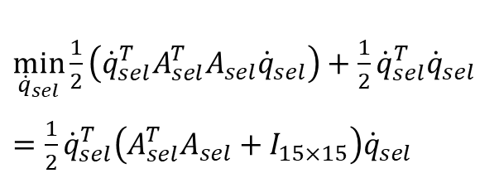
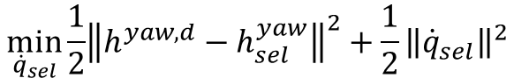
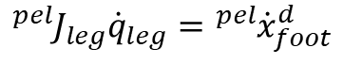
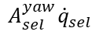
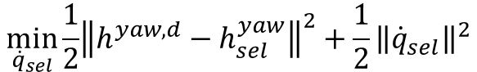
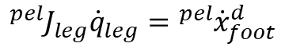
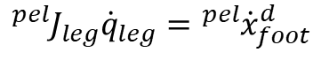
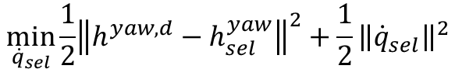
Centroidal dynamics
Objective function
0
$$\min_{{\dot{q}}_{sel}}\frac{1}{2}{{\left\|h^{yaw,d}−h_{sel}^{yaw}\right\|}^{2}+\frac{1}{2}{\left\|{\dot{q}}_{sel}\right\|}^{2}}$$
$$\min_{{\dot{q}}_{sel}}\frac{1}{2}{{\left\|h^{yaw,d}−h_{sel}^{yaw}\right\|}^{2}+\frac{1}{2}{\left\|{\dot{q}}_{sel}\right\|}^{2}}$$
$$A_{sel}^{yaw}{\dot{q}}_{sel}$$
s.t.
$${}_{ }^{pel}{J_{leg}}{\dot{q}}_{leg}={}_{ }^{pel}{{\dot{x}}_{foot}^{d}}$$
s.t.
$${}_{ }^{pel}{J_{leg}}{\dot{q}}_{leg}={}_{ }^{pel}{{\dot{x}}_{foot}^{d}}$$
Quadratic form of the objective function
0
$\min_{{\dot{q}}_{sel}}\frac{1}{2}\left({\dot{q}}_{sel}^{T}A_{sel}^{T}A_{sel}{\dot{q}}_{sel}\right)+\frac{1}{2}{\dot{q}}_{sel}^{T}{\dot{q}}_{sel}$
$=\frac{1}{2}{\dot{q}}_{sel}^{T}\left(A_{sel}^{T}A_{sel}+I_{15×15}\right){\dot{q}}_{sel}$
$$\min_{{\dot{q}}_{sel}}\frac{1}{2}{{\left\|h^{yaw,d}−h_{sel}^{yaw}\right\|}^{2}+\frac{1}{2}{\left\|{\dot{q}}_{sel}\right\|}^{2}}$$
$$A_{sel}^{yaw}{\dot{q}}_{sel}$$
s.t.
$${}_{ }^{pel}{J_{leg}}{\dot{q}}_{leg}={}_{ }^{pel}{{\dot{x}}_{foot}^{d}}$$
$$A_{sel}= \left[\begin{matrix}A_{leg, l} & \begin{matrix}A_{leg, r} & A_{waist, yaw} & A_{shoulder,pitch, l}\end{matrix} & A_{shoulder,pitch, r}\end{matrix}\right]$$

Slide 3
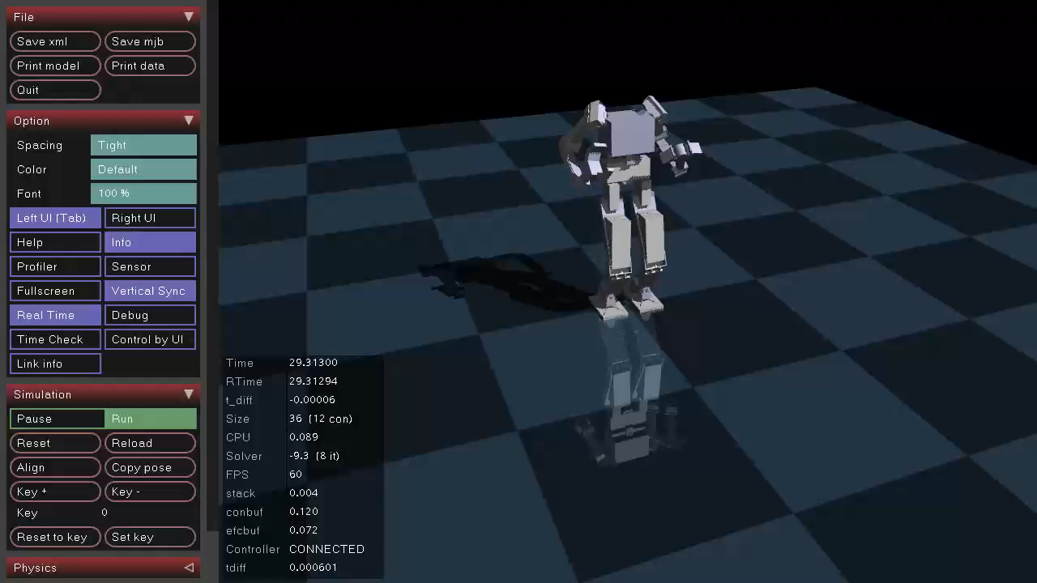
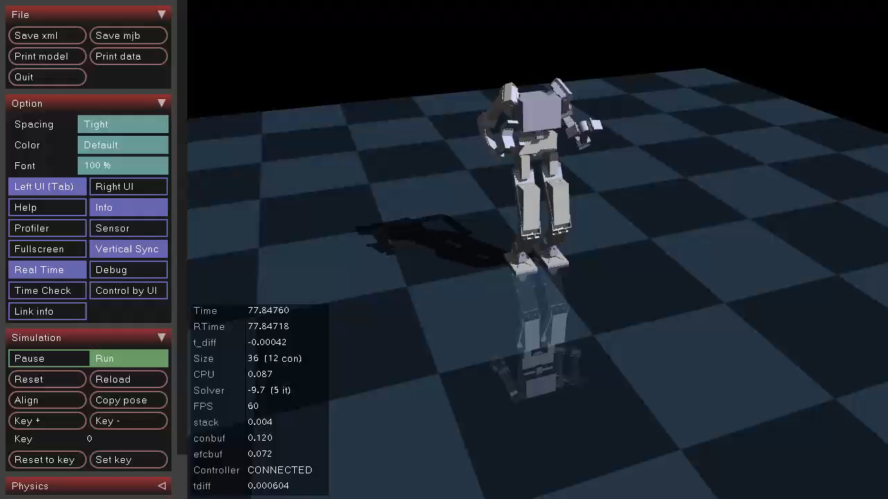
Simulation video
W/O momentum minimization
With momentum minimization

Slide 4
Simulation results
W/O momentum minimization
With momentum minimization

Slide 5
Simulation results
Left foot torque (yaw direction)
Right foot torque (yaw direction)

Slide 6
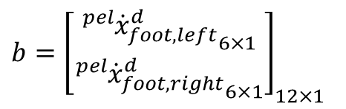
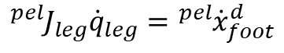
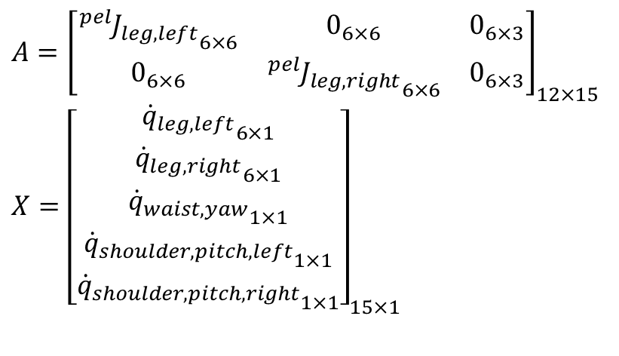
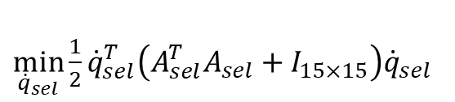
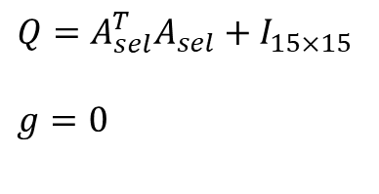
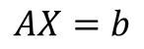
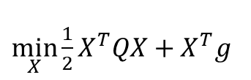
QPOASES
When using QPOASES..
$\min_{{\dot{q}}_{sel}}\frac{1}{2}{\dot{q}}_{sel}^{T}\left(A_{sel}^{T}A_{sel}+I_{15×15}\right){\dot{q}}_{sel}$
$\min_{X}\frac{1}{2}X^{T}QX+X^{T}g$
s.t.
$${}_{ }^{pel}{J_{leg}}{\dot{q}}_{leg}={}_{ }^{pel}{{\dot{x}}_{foot}^{d}}$$
s.t.
$$AX=b$$
$A={\left[\begin{matrix}{{}_{ }^{pel}{J_{leg,left}}}_{6×6} & 0_{6×6} & 0_{6×3} \\ 0_{6×6} & {{}_{ }^{pel}{J_{leg,right}}}_{6×6} & 0_{6×3}\end{matrix}\right]}_{12×15}$ $X={\left[\begin{matrix}{{\dot{q}}_{leg, left}}_{6×1} \\ {{\dot{q}}_{leg, right}}_{6×1} \\ \begin{matrix}{{\dot{q}}_{waist, yaw}}_{1×1} \\ {{\dot{q}}_{shoulder,pitch, left}}_{1×1} \\ {{\dot{q}}_{shoulder, pitch, right}}_{1×1}\end{matrix}\end{matrix}\right]}_{15×1}$
$b={\left[\begin{aligned}{{}_{ }^{pel}{{\dot{x}}_{foot,left}^{d}}}_{6×1} \\ {{}_{ }^{pel}{{\dot{x}}_{foot,right}^{d}}}_{6×1}\end{aligned}\right]}_{12×1}$
$Q=A_{sel}^{T}A_{sel}+I_{15×15}$
$g=0$

Slide 7
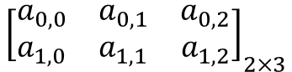
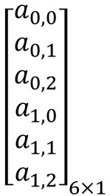
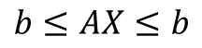
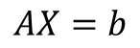
QPOASES
Matrix form should be changed to vector form (Because all of the variable types (real_t type) used in QPOASES are vector types)
$${\left[\begin{aligned}a_{0,0} \\ a_{0,1} \\ a_{0,2} \\ a_{1,0} \\ a_{1,1} \\ a_{1,2}\end{aligned}\right]}_{6×1}$$
$${\left[\begin{matrix}a_{0,0} & a_{0,1} & a_{0,2} \\ a_{1,0} & a_{1,1} & a_{1,2}\end{matrix}\right]}_{2×3}$$
Matrix form
Vector form
Equality constraints should be changed to Inequlality constraints. (For use in QPOASES)
$$AX=b$$
$$b≤AX≤b$$

Slide 8
QPOASES
void WalkingController::QPController(VectorQd& optimal_q_dot)
{
real_t Q_input[15*15], A_input[12*15], lbb_input[12], ubb_input[12], lbx_input[15], ubx_input[15], g_input[15];
real_t qOpt[15];
QProblem test(15,12);
Options options1;
options1.initialStatusBounds = ST_INACTIVE;
options1.numRefinementSteps = 1;
options1.enableCholeskyRefactorisation = 1;
options1.printLevel = PL_NONE;
test.setOptions(options1);
int_t nWSR1= 1000;
test.init(Q_input,g_input,A_input,lbx_input,ubx_input,lbb_input,ubb_input,nWSR1);
test.getPrimalSolution(qOpt);
}
Define the A matrix (Jacobian matrix, 12 x 15)
Define the b vector (Desired foot velocity, 12 x 1)
Define the Q matrix (Centroidal momentum matrix & Identity, 15 x 15)
Q matrix 대입
A matrix 대입
Equality constraint
Solution X 값의 범위 지정
g값 대입
4. Put a value in the variable. (Q_input, g_input, lbx_input, ubx_input, A_input, lbb_input, ubb_input)
Solution

